Slide 1
The treasure hunt: Encouraging physical activity for arthritis patients
Saba Akhyani
IAT 806 – Interdisciplinary approaches
To artistic programming

Slide 2
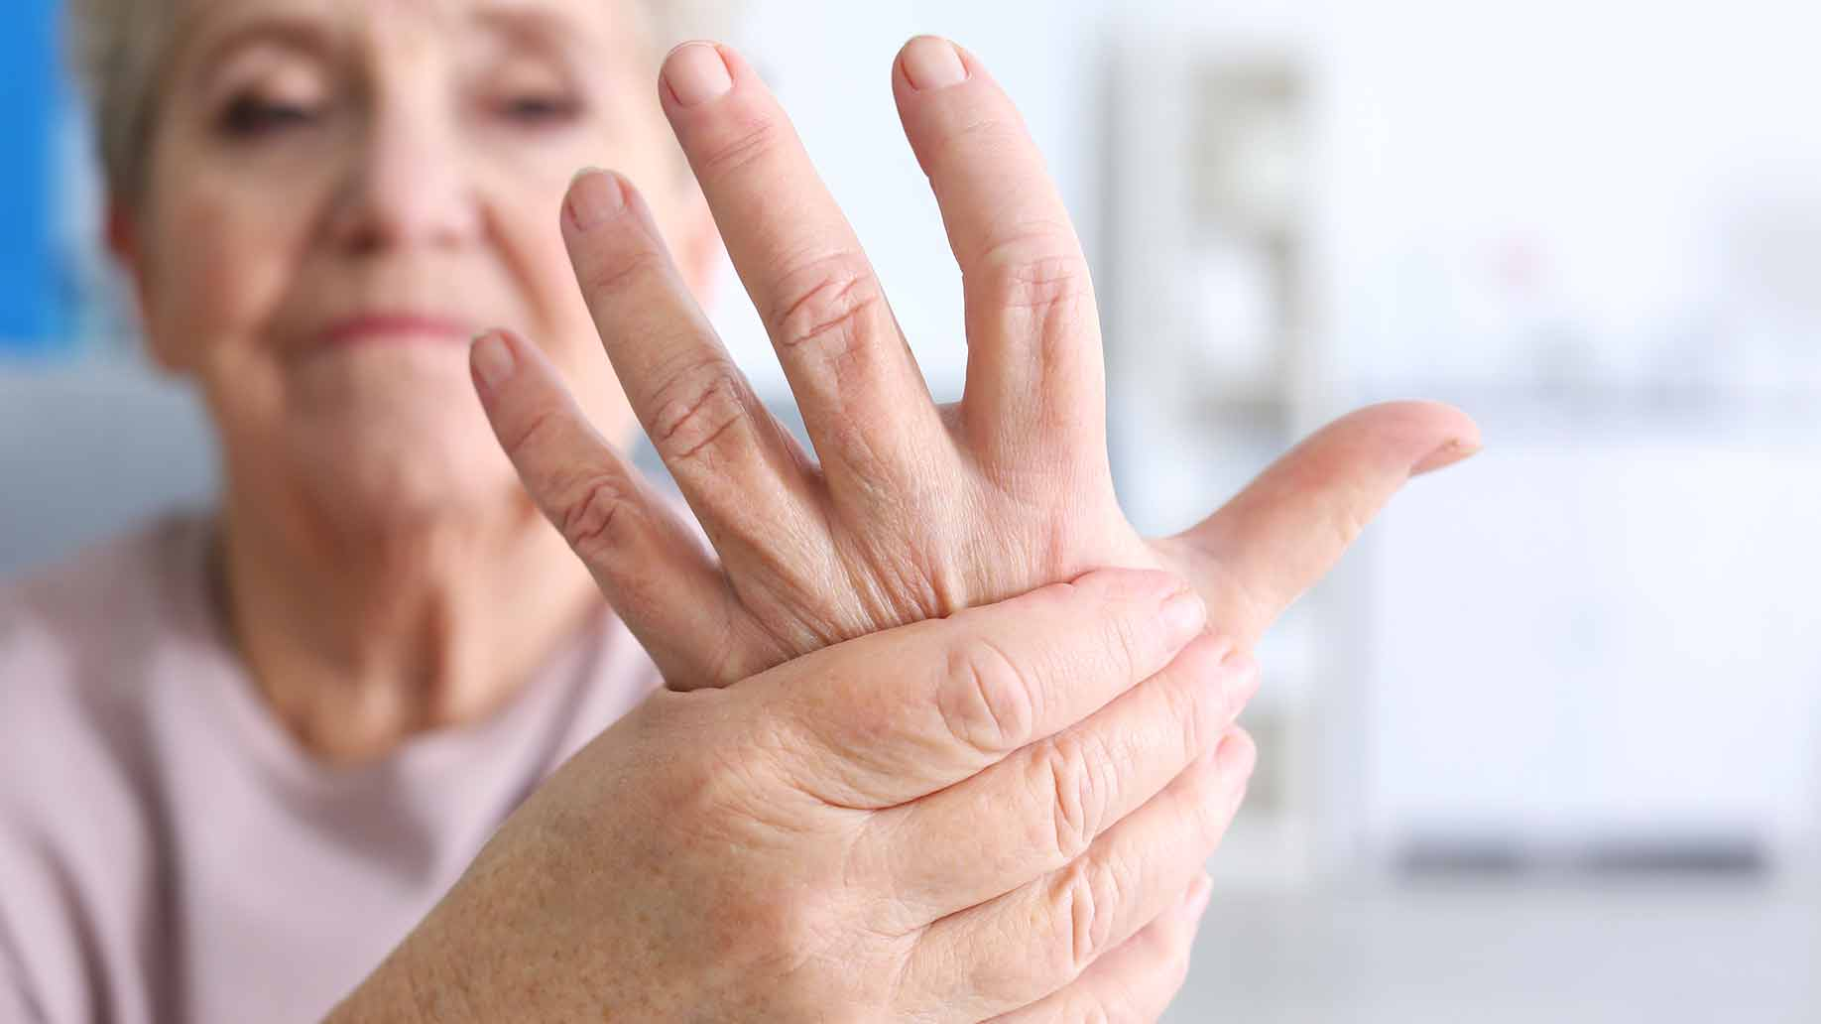
Introduction
What?
Promoting physical activity
Target Users : Arthritis patients
Investigate elderly arthritis patients experience and feedback on TreasureHunt, especially how they felt about the difficulty of the game interactions and the ease of control.

Slide 3
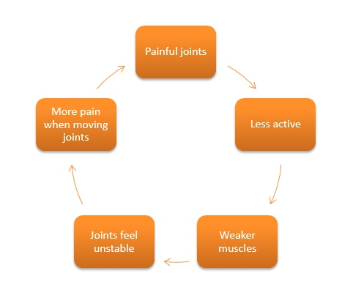
Motivation
Why?
Motivation to move!
Arthritis patients:
Affects 1 in 100 in Canada.
Painful!
Important for maintaining their disease
Notes:
Motivations plays a key role for an active lifestyle. However, After a long day, people are usually not motivated enough to be physically active.
. For arthritis patients, who are also a large popluation in canada, it is even harder because being physically active can be painful,
even though they are recommended to maintain a physically active lifestyle to successfully manage arthritis disease.

Slide 4
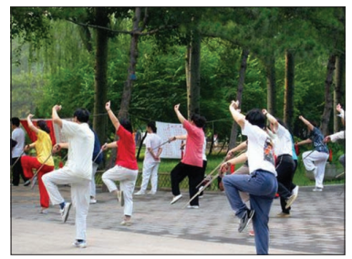
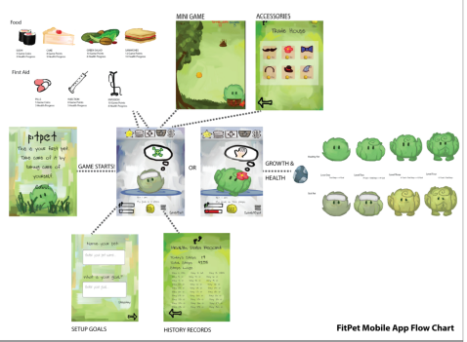
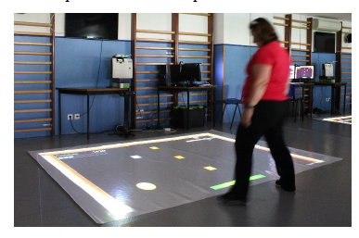
Related Works:
Home-based Taichi ( Brismee et al, 2007)
ExerPong ( Muñoz et al, 2018)
FitPet (Xin et al, 2015)
Notes:
They have been a lot of studies trying to show that physical activity can help arthritis people with their pain.
Taichi movements to motivate people with arthritis to be more physically active.
Many studies have also shown the positive effects of interacting with VE or playing games
for older adults’ health .
There have also been a couple of “exergames” for older people, like exerpong.
Another one is studies specifically for arthritis patiens but not through VE. One of these appliactions is FitPet, which tries to motivate arthritis patients with a virtual pet. It is a gamified approach that You have to move so that the pet remains healthy.

Slide 5
Research Goal
So what?
Game to promote physical activity for arthritis patients
More motivation ?
Get feedback on the task ( difficulty / Game interactions)
Notes:
However, what I am interested in, as olders are good with Virtual environments,
The previous studies were not focusing on a VR game for specifically arthritis patients.
Therefore, I will make a VR game which I think the arthritis patients will be motivated to complete daily goals.

Slide 6
Method
Design a Maze-Based Game !
Notes:
In order to reach this goal, I have designed a game to promote physical activity. Firstly, they have to move throughout the maze.
There are also a couple of items they have to interact with which require physical movement.
Additionally, there are some tiles which include specific tasks that the player has to complete.
This way, patients might be more motivated to complete the daily physical goal by playing.
The actual 3D version in going to be implemented later.

Slide 7
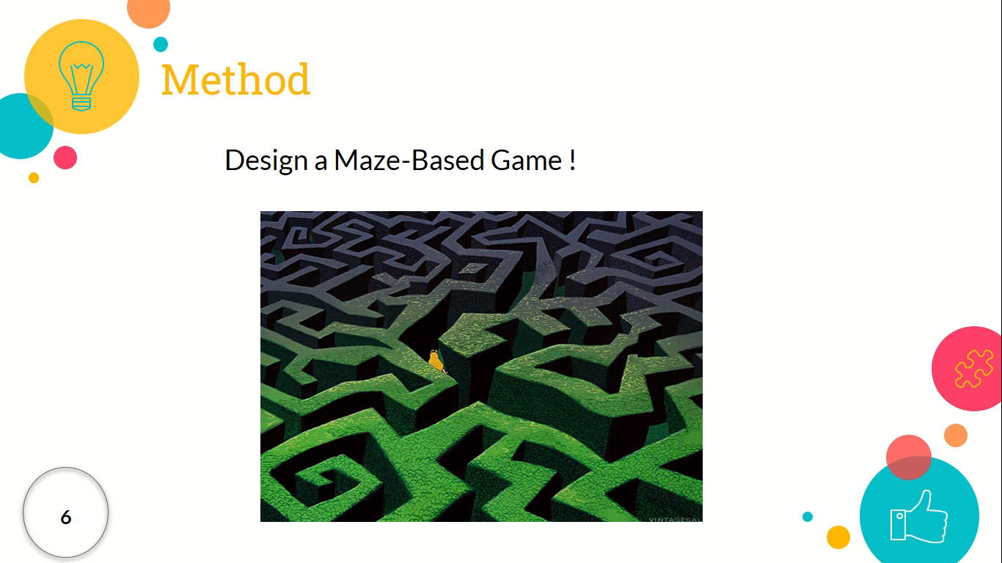
Demo
Notes:
In the first section, by the end of 1970s, of modern computing and GUI were already practically implemented and refined
by the developers at Xerox Parc but they were not yet commercially available to
consumers

Slide 8
Future Works
Change to 3D version!
Define better tasks for enhancing range of motion!

Slide 9
References
[1] Chodzko-Zajko, Wojtek J., David Nathan Proctor, Maria A. Fiatarone Singh, Christopher T. Minson, Claudio R. Nigg, George J. Salem, and James S. Skinner. 2009. “Exercise and Physical Activity for Older Adults.” Medicine and Science in Sports and Exercise 41(7):1510–30.
[2] Van den Ende, C. H., F. C. Breedveld, S. le Cessie, B. A. Dijkmans, A. W. de Mug, and J. M. Hazes. 2000. “Effect of Intensive Exercise on Patients with Active Rheumatoid Arthritis: A Randomised Clinical Trial.” Annals of the Rheumatic Diseases 59(8):615–21.
[3] Brismée, Jean-Michel, Robert L. Paige, Ming-Chien Chyu, Julie D. Boatright, James M. Hagar, Joseph A. McCaleb, Mauricio M. Quintela, Du Feng, Ke T. Xu, and Chwan-Li Shen. 2007. “Group and Home-Based Tai Chi in Elderly Subjects with Knee Osteoarthritis: A Randomized Controlled Trial.” Clinical Rehabilitation 21(2):99–111.
[4] Muñoz, John E., M. Cameirão, S. Bermúdez i Badia, and E. Rubio Gouveia. 2018. “Closing the Loop in Exergaming - Health Benefits of Biocybernetic Adaptation in Senior Adults.” Pp. 329–339 in Proceedings of the 2018 Annual Symposium on Computer-Human Interaction in Play, CHI PLAY ’18. New York, NY, USA: ACM.
[5] Tong, Xin, Diane Gromala, Chris Shaw, and Weina Jin. 2015. “Encouraging Physical Activity with a Game-Based Mobile Application: FitPet.” Pp. 1–2 in 2015 IEEE Games Entertainment Media Conference (GEM).

